Slide 1
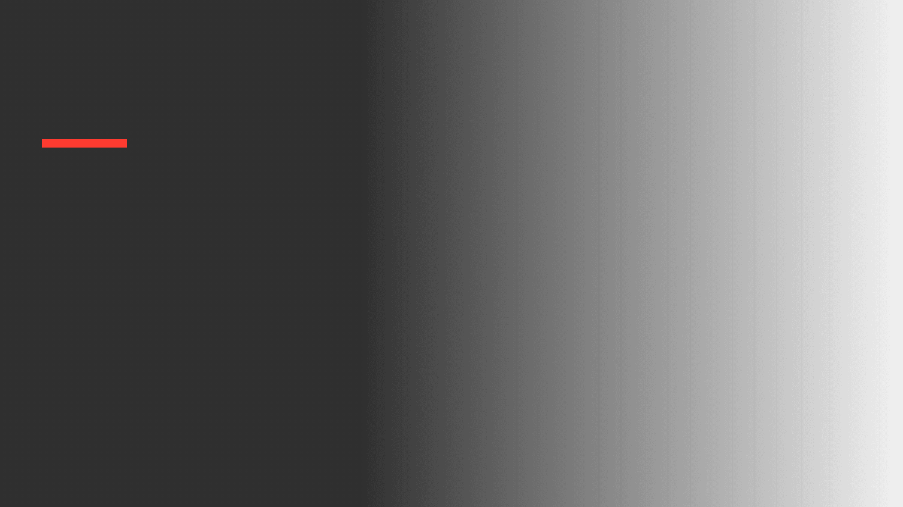
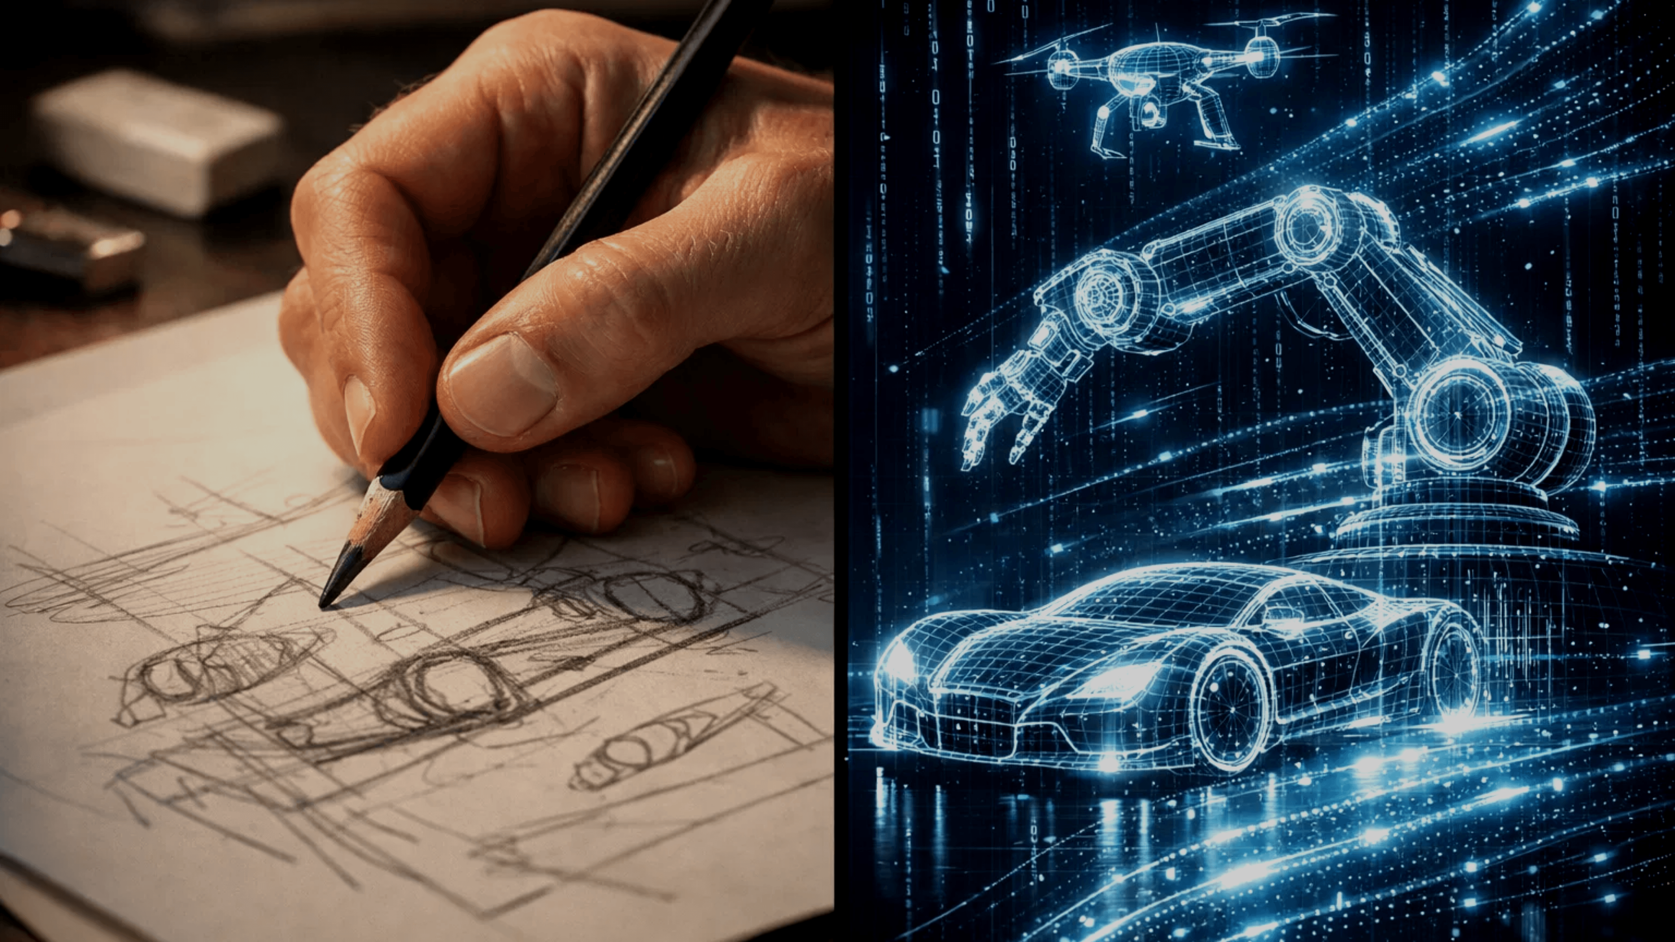
The Effects of Generative AI on Design Fixation
Are tools like Midjourney making us less creative?
Paper Presentation

Slide 2
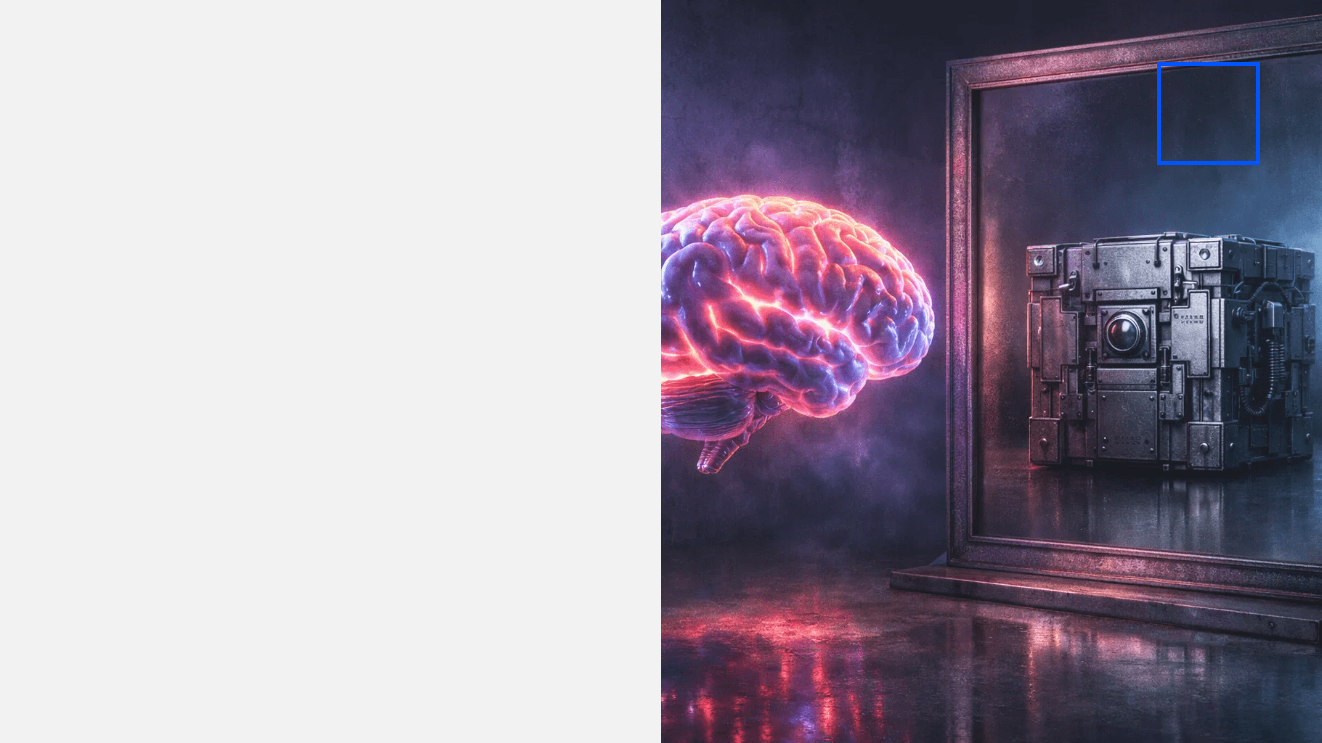
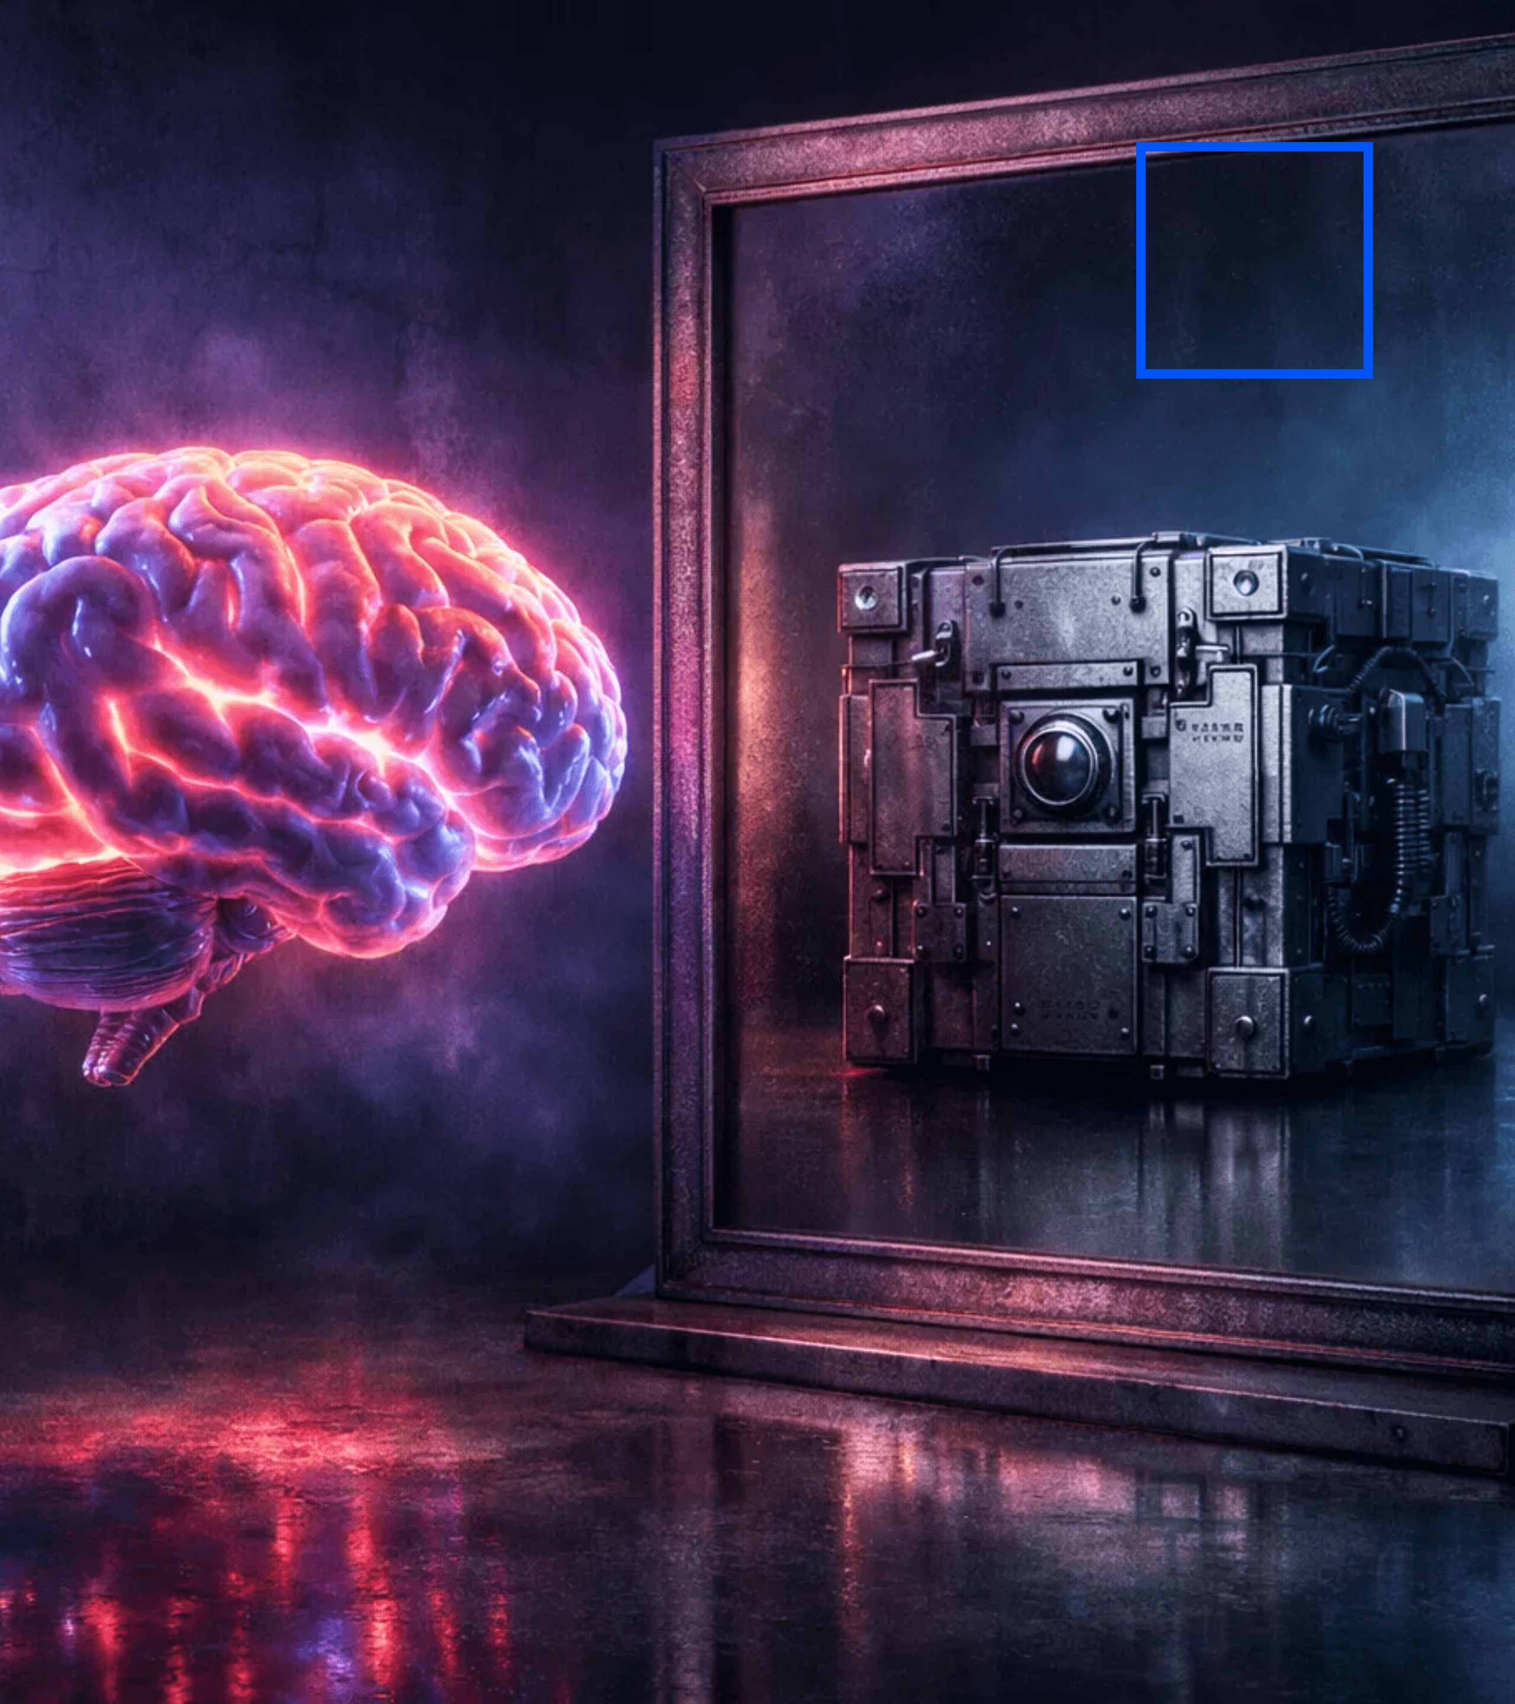
The "Gold Rush" of Generative AI
The Context
Unprecedented adoption across creative industries.
The Conflict
It often mirrors and reinforces existing biases.
Key Concept
AI as a mirror, not a muse.

Slide 3
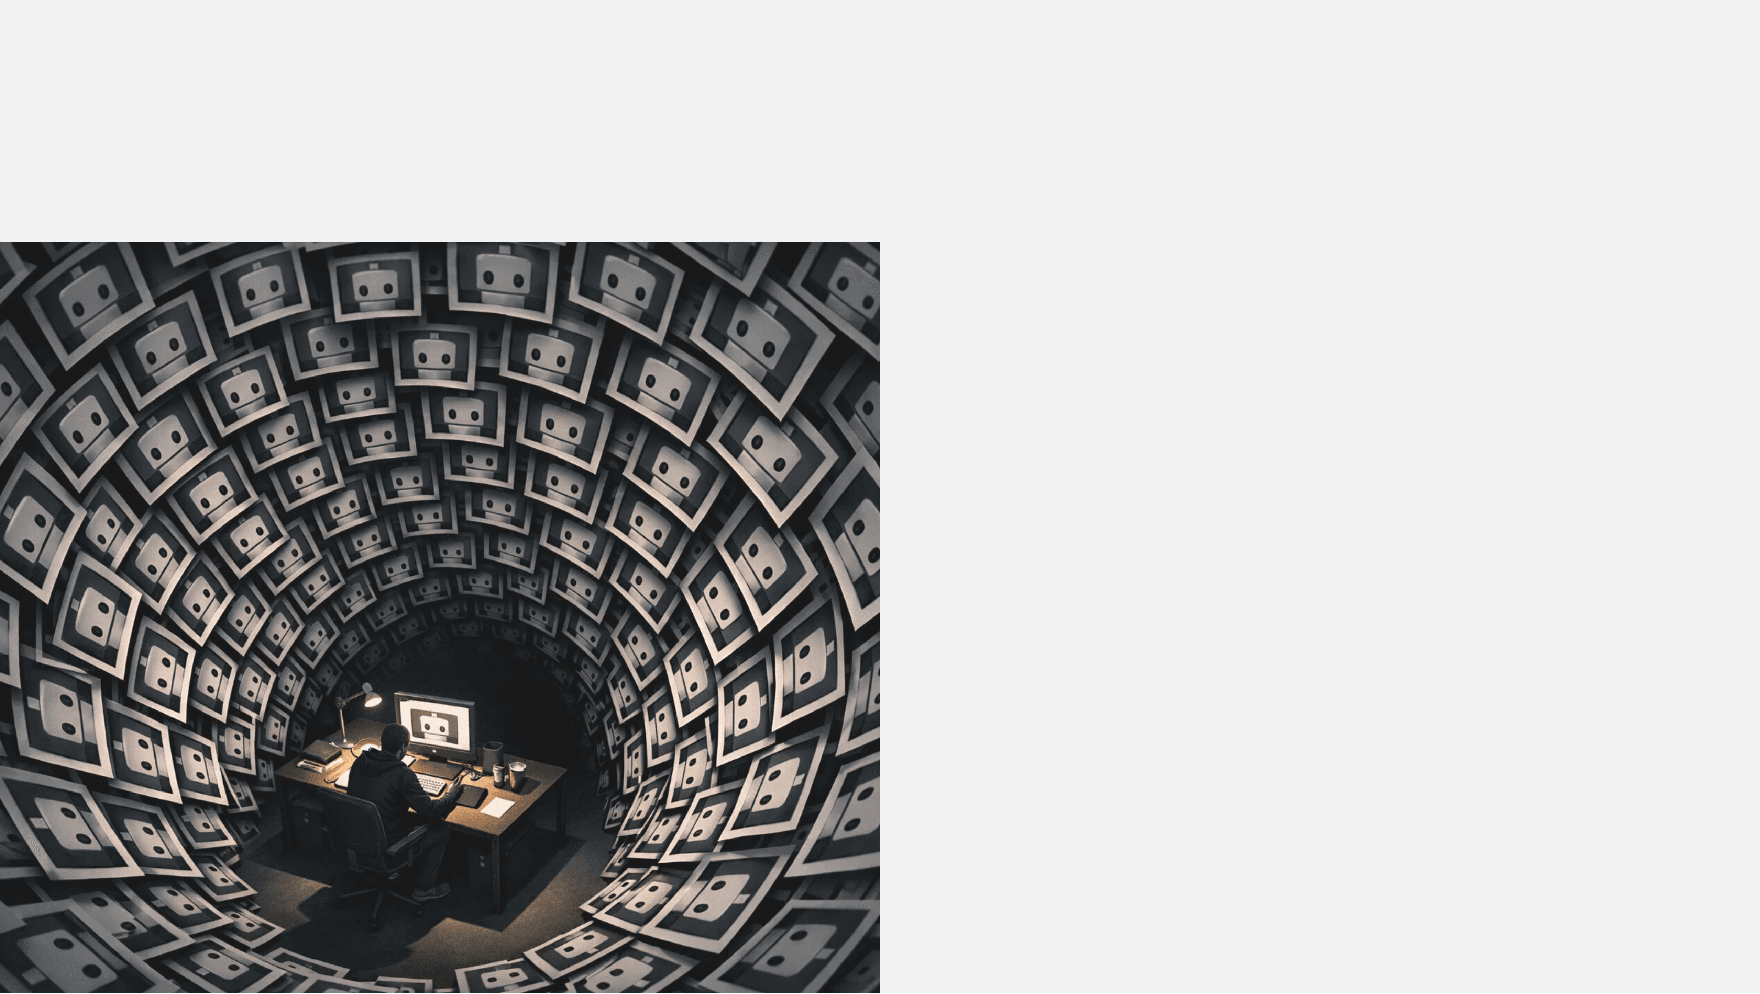
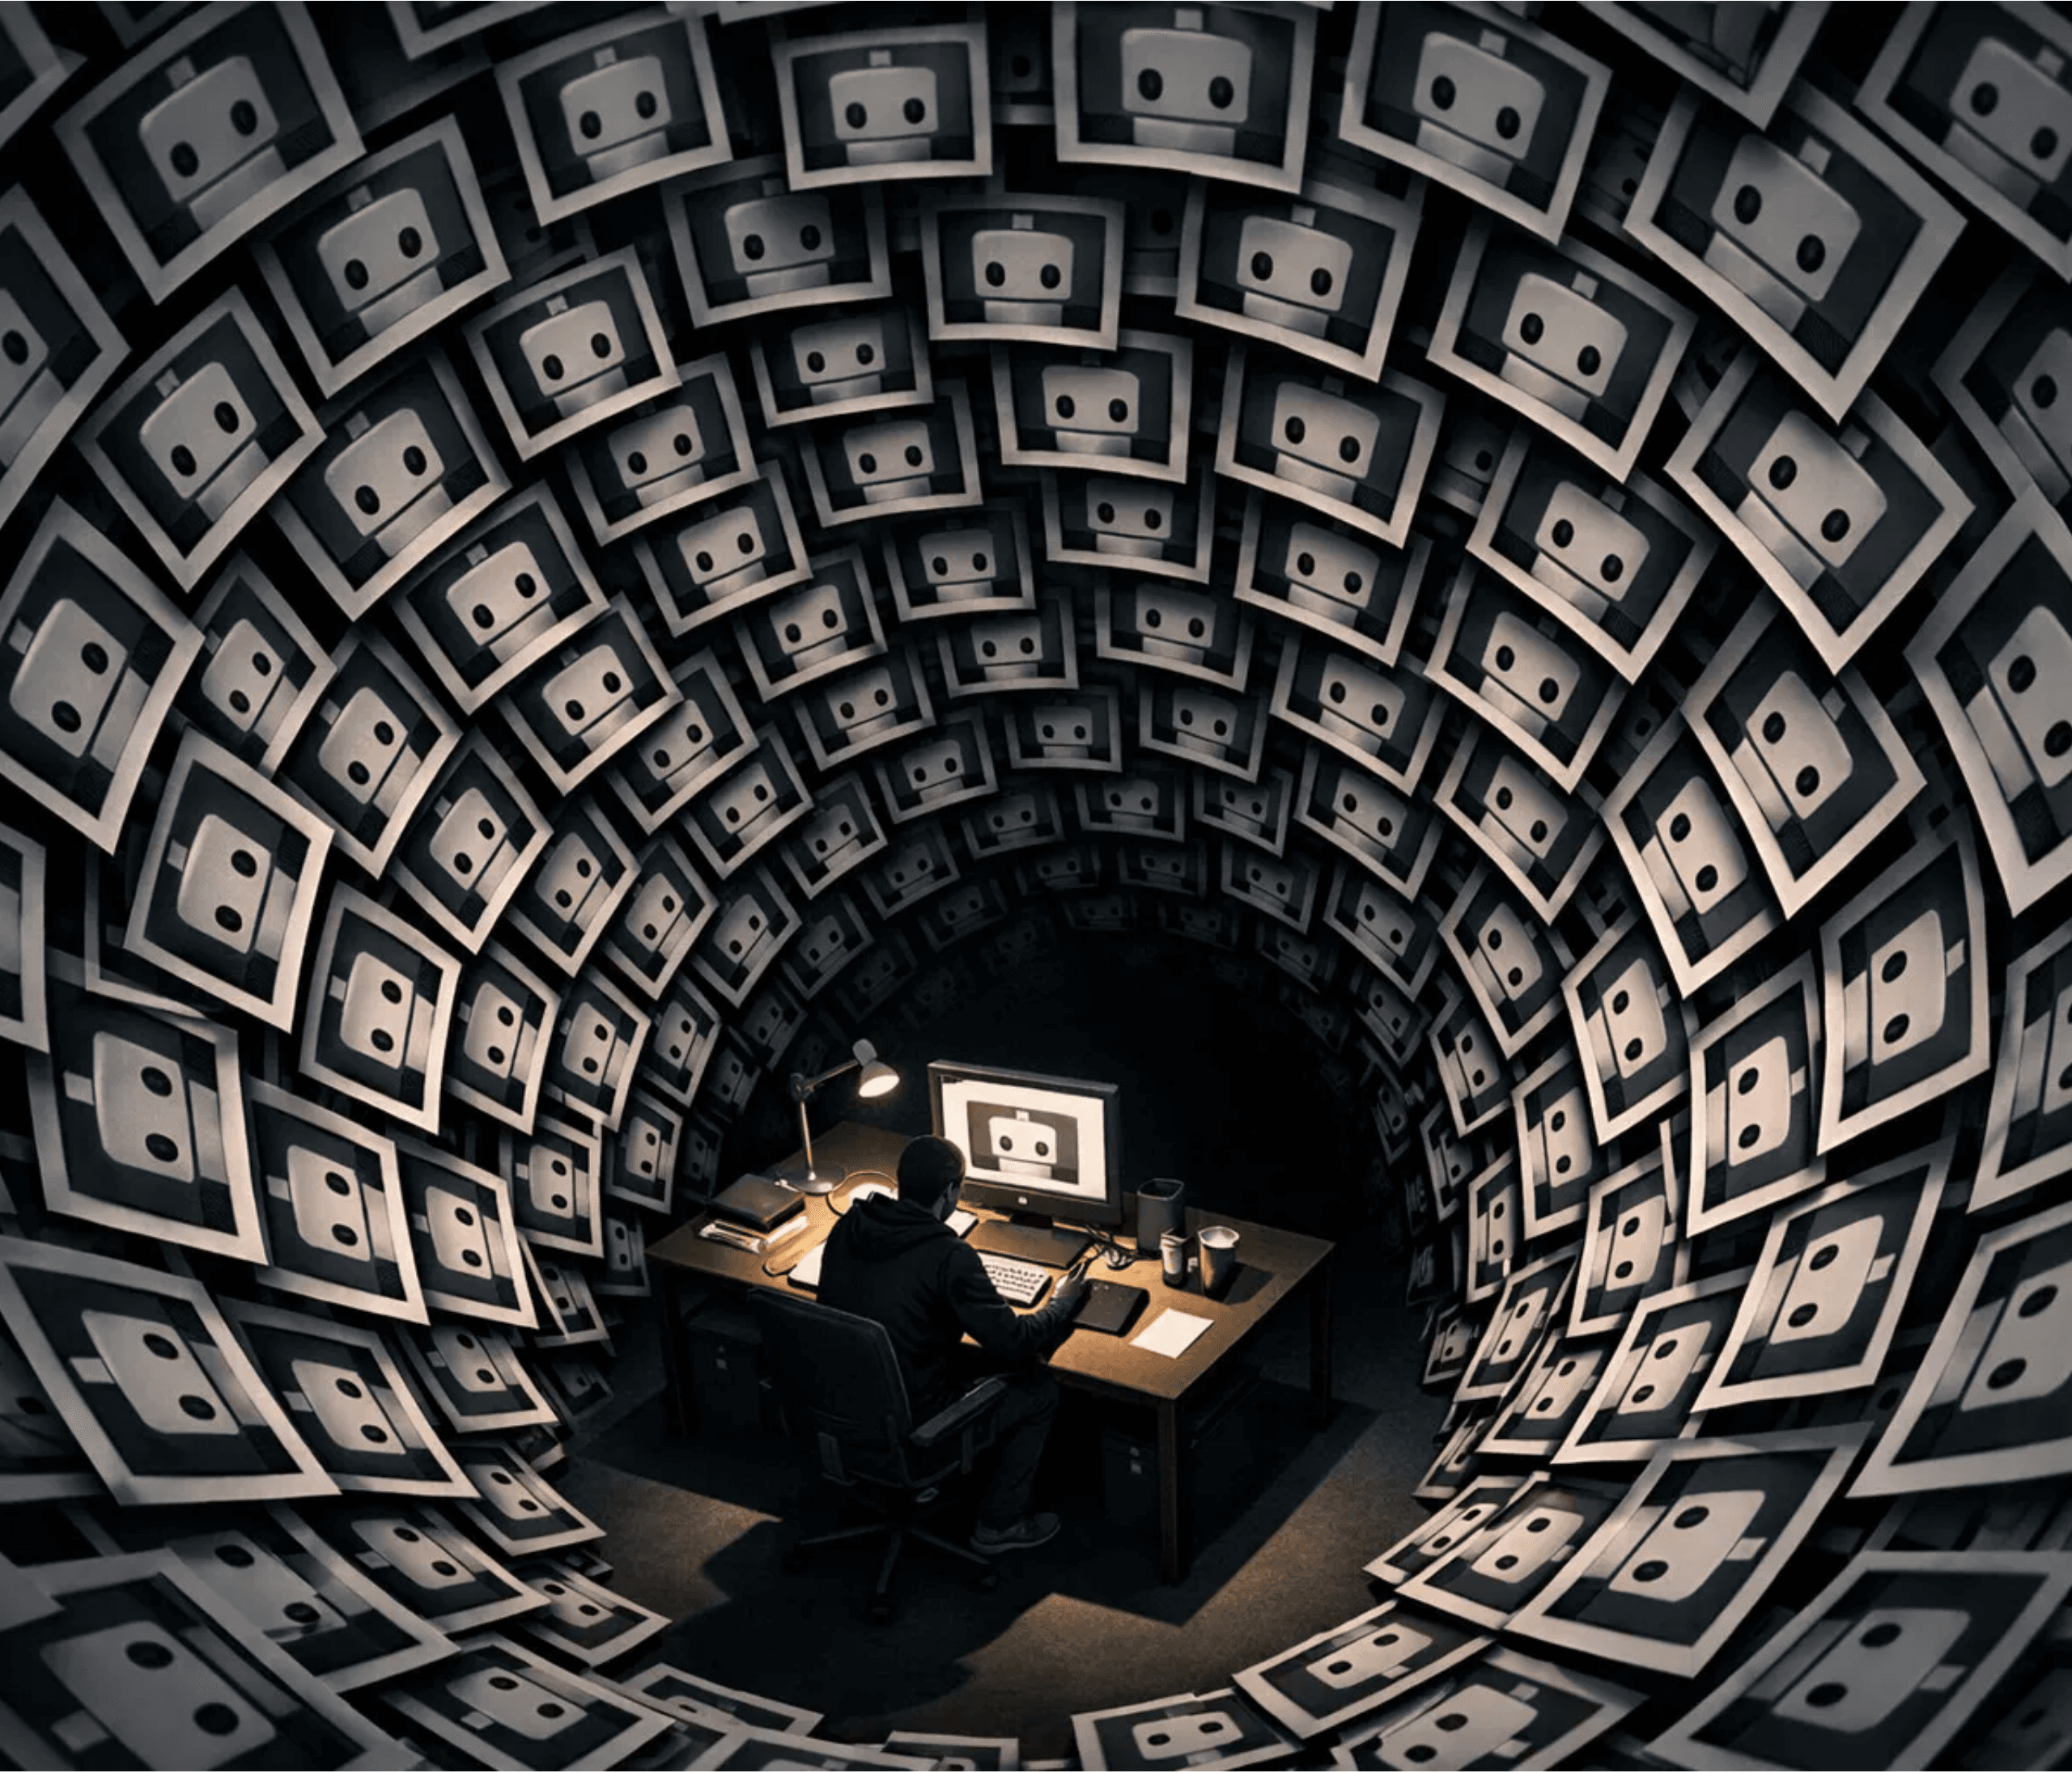
Understanding Design Fixation
Definition
"Blind adherence to a set of ideas or concepts limiting the output of conceptual design."
— Jansson & Smith, 1991
The Core Issue
When designers fixate on prior examples, they inadvertently constrain their exploration space, reducing diversity.
The Research Gap
We lack empirical data on how high-fidelity tools like Midjourney impact fixation in real-world workflows.

Slide 4
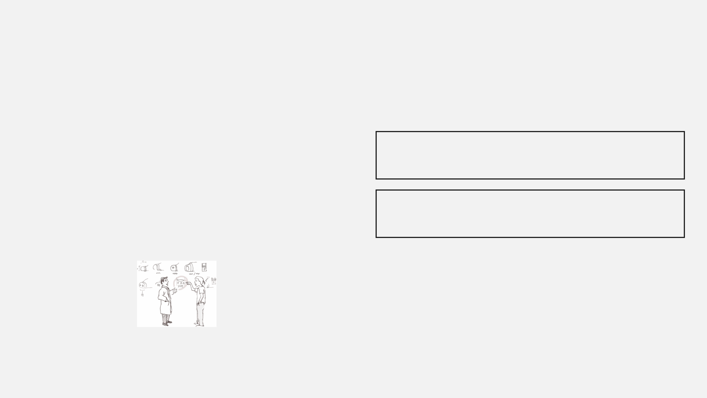


Research Methodology
60
3 Experimental Conditions
Designers
01
Baseline
No Tools
The Task
Sketch a "kind, caring, intelligent" chatbot avatar.
The Trigger
02
Image Search
Google Images
All participants shown the same initial example image to establish baseline.
03
GenAI
Midjourney

Slide 5
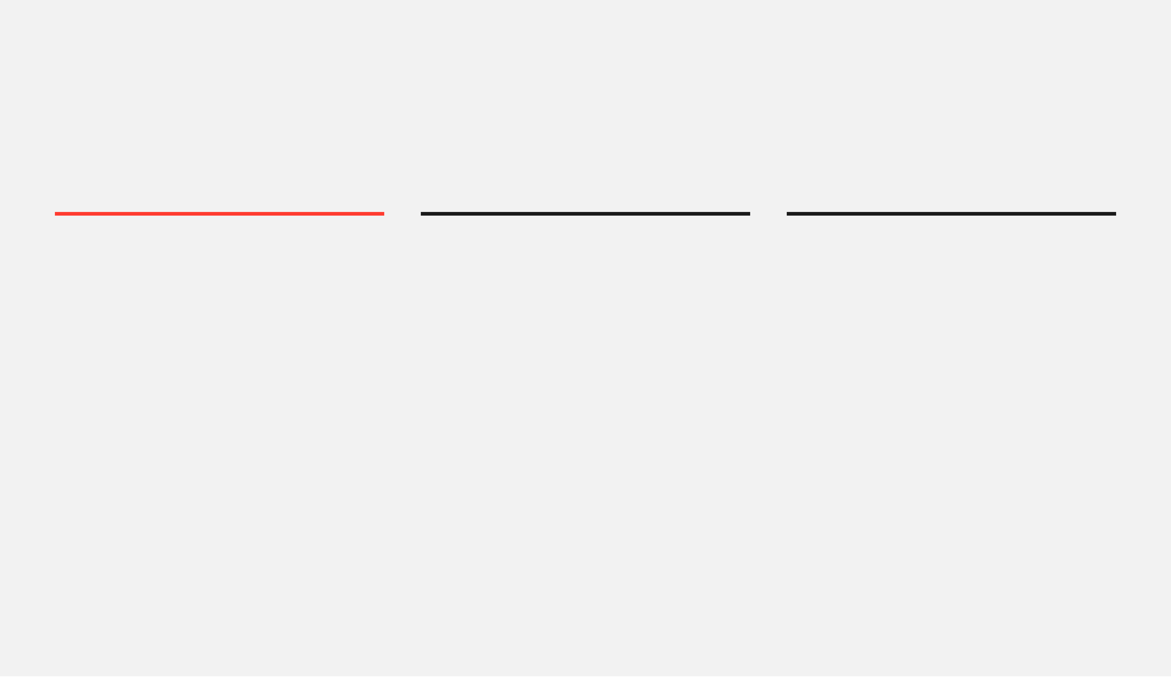
Key Findings Reveal Increased Fixation
Fixation Scores
Reduced Variety
Diminished Originality
The GenAI group demonstrated the highest fixation scores, showing significantly more copying behavior from the initial example.
Participants using Midjourney produced fewer distinct ideas and explored fewer conceptual categories compared to baseline.
Ideas generated with AI assistance were measurably less unique and novel when evaluated against baseline creative output.
The tool designed to enhance creativity actually constrained it.
The Paradox

Slide 6
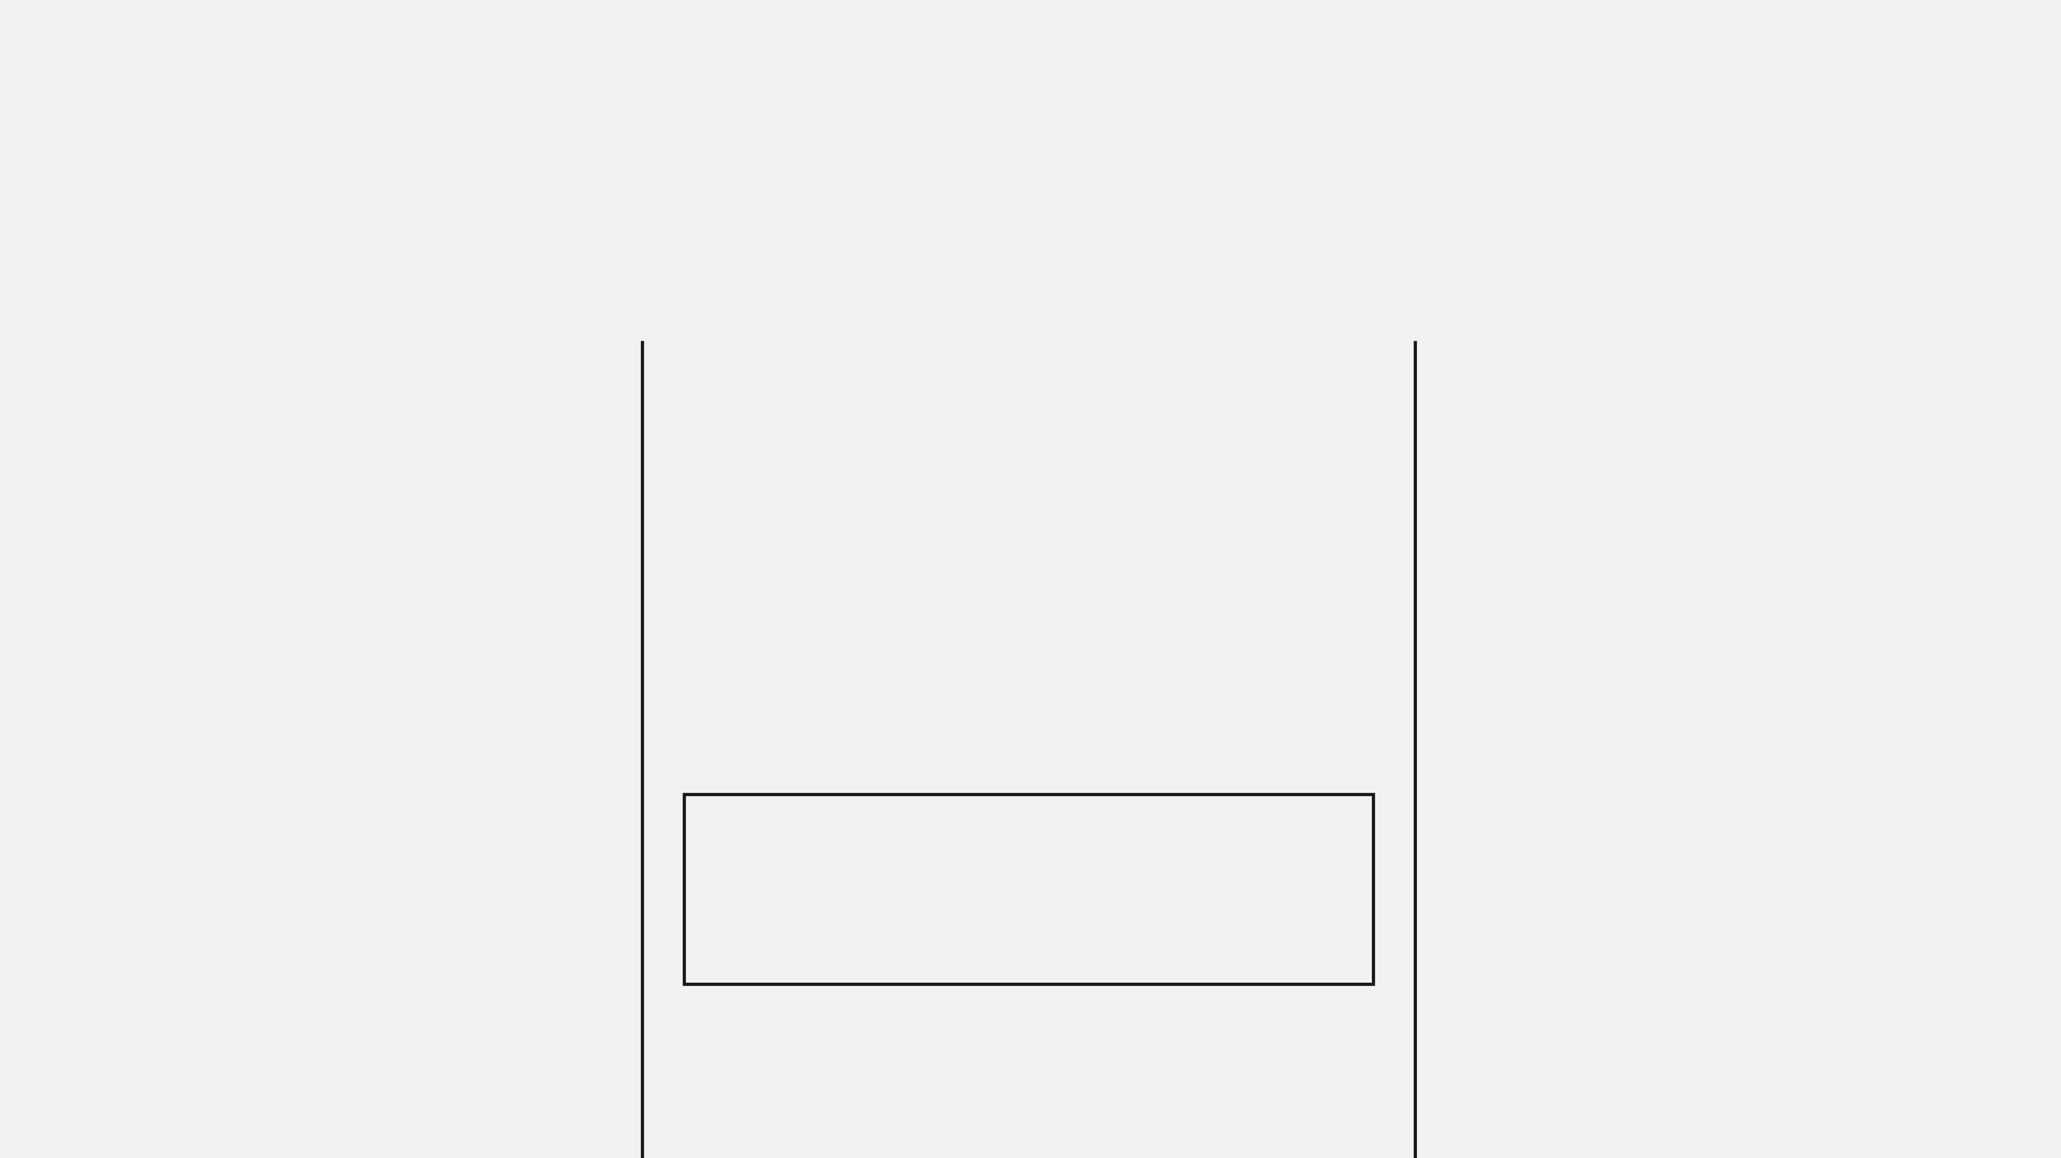
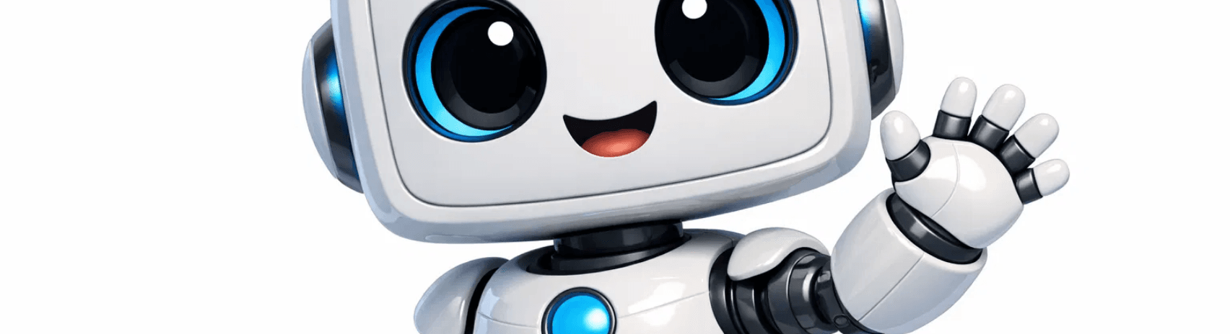
Understanding the Mechanisms Behind Fixation
01
02
03
Lazy Prompting
High Fidelity Trap
Fixation Displacement
Designers copied words directly from the brief into Midjourney without conceptual translation.
Polished images created psychological pressure to accept and replicate rather than iterate.
Designers began fixating on their own AI-generated outputs instead of the original example.
Result: Predictable, homogeneous results.
Result: A recursive loop of narrowing creativity.
What participants "copied"
Result: Visual authority discourages exploration.

Slide 7
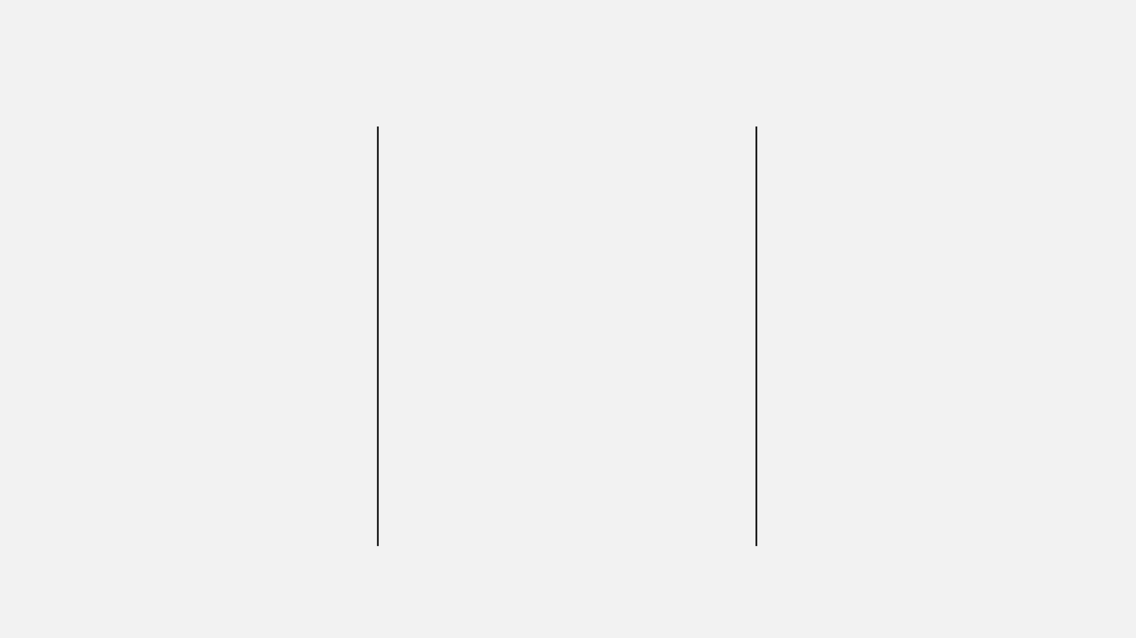
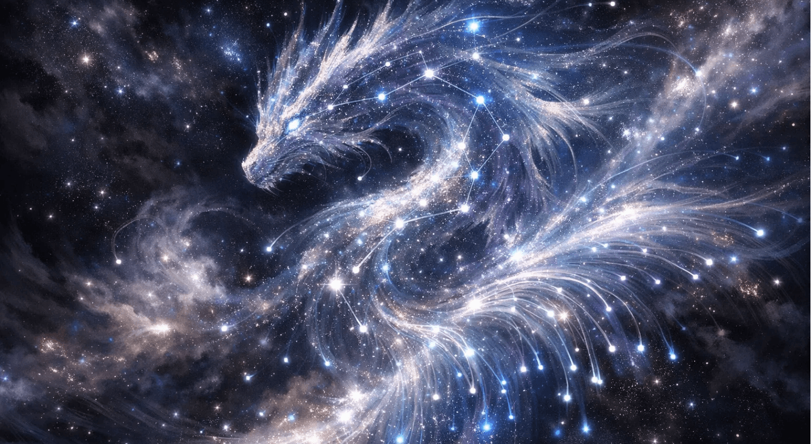
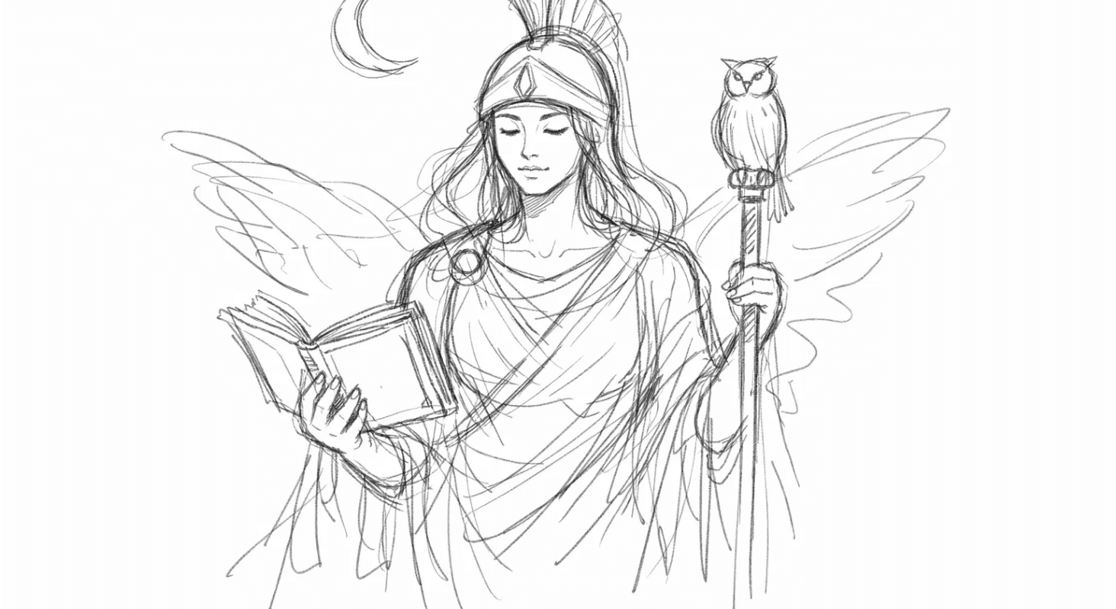
Implications for Design Practice
Scaffold Prompting
Lower Fidelity Outputs
Prompt Diversity
Encourage metaphorical and abstract thinking rather than literal description.
Intentionally generate blurry or abstract images to invite interpretation and iteration.
Mechanisms that automatically vary prompts to expand exploration space and avoid local minima.
"AI should function as a creative partner that challenges thinking, not as a shortcut."
Metaphor: "Intelligence" as a Dragon
Low Fidelity: Wisdom as a Sketch
AI is a partner, not a shortcut.

Slide 8
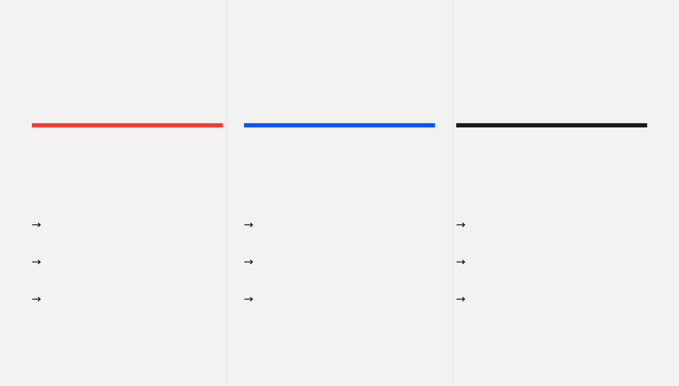
Future Research Directions
01
02
03
Methodological Extensions
Tool Design Research
Theoretical Development
→
Longitudinal studies tracking fixation effects over extended creative projects
→
Developing and testing scaffolding interfaces for generative AI
→
Refining models of human-AI creative collaboration
→
Cross-cultural studies examining how different design cultures interact with AI
→
Exploring optimal fidelity levels for different stages of the process
→
Understanding cognitive mechanisms of AI-induced fixation
→
Comparative analysis across different generative AI platforms
→
Investigating hybrid human-AI workflows balancing efficiency with exploration
→
Developing frameworks for responsible AI tool design in creative domains

Slide 9
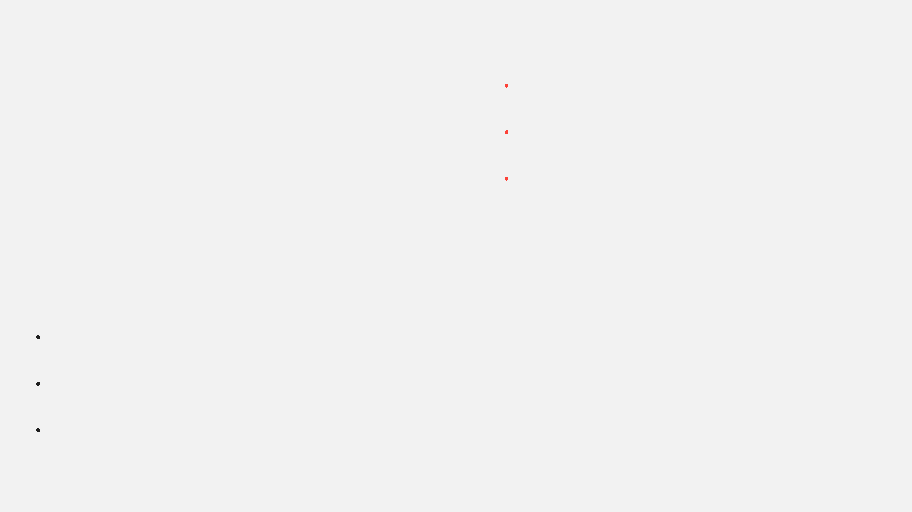
For Individual Designers
Practical Recommendations for Designers
•
Resist the urge to use first-generation outputs; iterate deliberately.
•
Experiment with abstract and metaphorical prompts rather than literal descriptions.
•
Use AI tools in early ideation phases, but return to manual sketching for divergent exploration.
For Design Teams
For Tool Developers
•
Establish protocols that require multiple rounds of AI-assisted ideation before convergence.
•
Design interfaces that promote prompt diversity and discourage lazy prompting.
•
Create critique sessions specifically focused on identifying fixation patterns.
•
Implement features that deliberately introduce variation and constraint.
•
Balance AI tool use with traditional brainstorming and sketching methods.
•
Consider adaptive fidelity systems that adjust output polish based on creative stage.

Slide 10
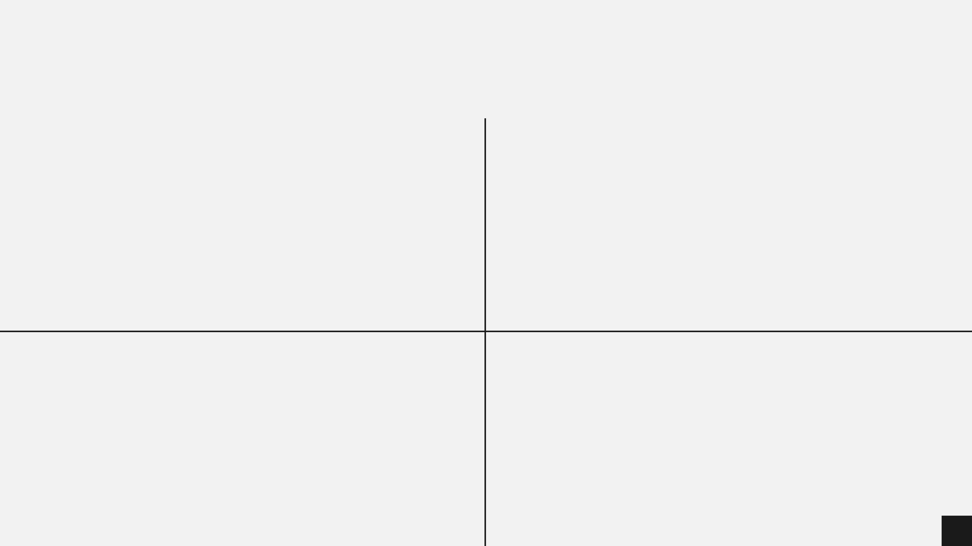
Broader Implications for Creative AI
Beyond Design
The Responsibility Question
The fixation phenomenon likely extends to other creative domains including writing, music composition, and architectural design.
As AI tools become ubiquitous, who bears responsibility for maintaining creative diversity—users, tool designers, or platform providers?
The Education Challenge
The Cultural Impact
Design education must evolve to teach critical AI literacy alongside traditional creative skills to navigate potential pitfalls.
If entire generations train on AI tools that induce fixation, we risk cultural homogenization of visual language and expression.

Slide 11
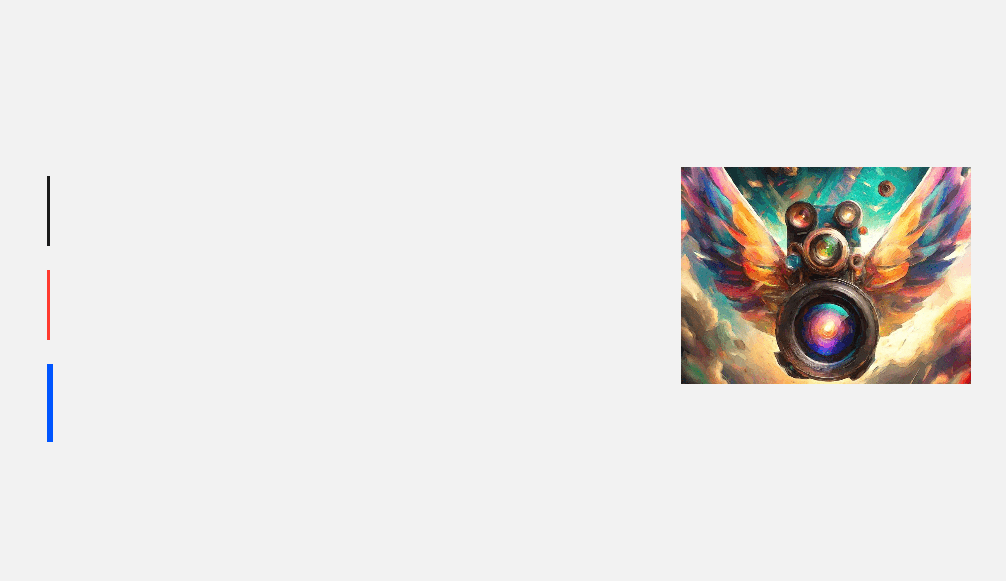
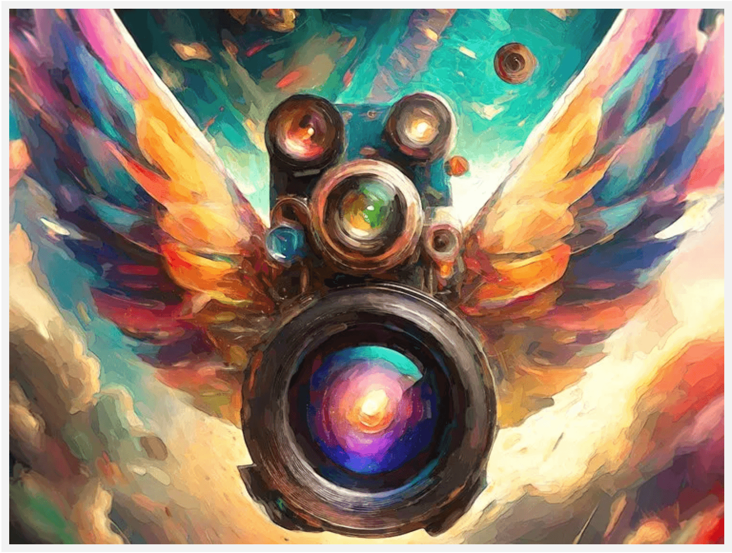
Reframing the AI-Creativity Relationship
The Current Narrative
AI as Creative Amplifier
More ideas, faster iteration, democratized access.
The Evidence-Based Reality
AI as Creative Constraint
Passive use leads to fewer unique ideas and homogeneity.
The Path Forward
AI as Creative Scaffold
Visual Metaphor: AI as a Creative Lens
Tools designed to challenge assumptions and expand the solution space.
Key Insight: The problem is not generative AI itself, but how we design these tools and how we teach designers to use them.
SCAFFOLD

Slide 12
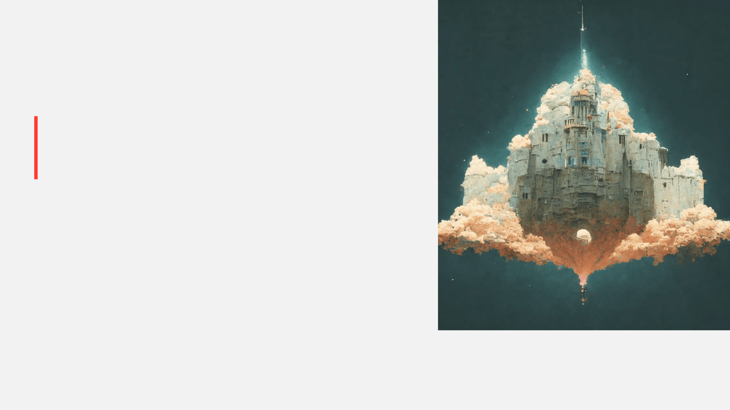

Conclusion & Call to Action
What We Learned
High-fidelity generative AI tools can paradoxically reduce creative output quality by inducing design fixation through lazy prompting and over-reliance on polished outputs.
The Call to Action
Researchers
Tool Developers
Investigate scaffolding mechanisms and optimal human-AI workflows.
Design for creative exploration, not just output generation.
Designers
Educators
Develop critical AI literacy and intentional tool use practices.
Integrate evidence-based AI pedagogy into design curricula.
Final Thought
"AI is neither muse nor mirror—it is what we design it to be. Let's design for creativity, not convenience."

